Slide 1
PHENIX Preliminary Data Request
Plenary Presentation
Name: Attila Bagoly, Máté Csanád
PWG: PLHF
What Observable: 3 particle B-E corr. strength
System, Energy, Run: Au+Au, 200 GeV, Run-10
Last PWG Presentation Date: December 22, 2016
Last PWG Presentation Link: abagoly_threeparticleHBT_final1.pdf
Analysis Note #: 1288
Analysis Note Web Link: analysisnote.pdf

Slide 2
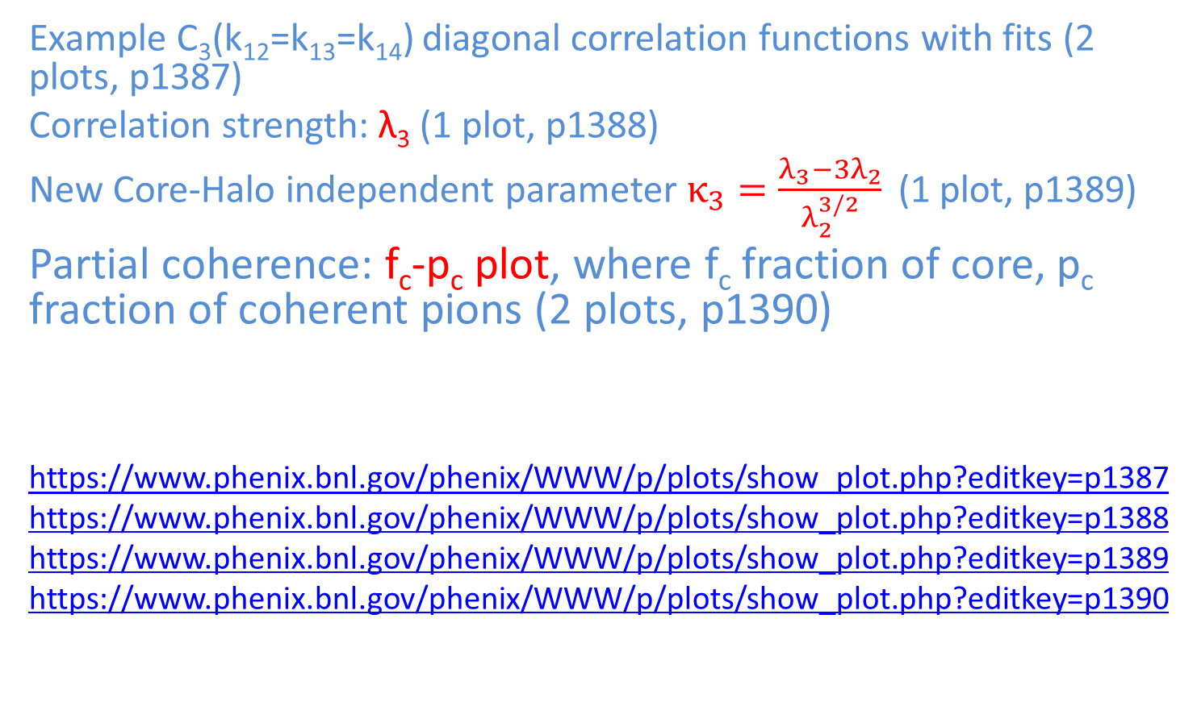
What plots are requested preliminary?
Example C₃(k₁₂=k₁₃=k₁₄) diagonal correlation functions with fits (2 plots, p1387)
Correlation strength: λ₃ (1 plot, p1388)
New Core-Halo independent parameter $κ_{3}=\frac{λ_{3}−3λ_{2}}{λ_{2}^{3/2}}$ (1 plot, p1389)
Partial coherence: f_{c}-p_{c} plot, where f_{c} fraction of core, p_{c} fraction of coherent pions (2 plots, p1390)
https://www.phenix.bnl.gov/phenix/WWW/p/plots/show_plot.php?editkey=p1387
https://www.phenix.bnl.gov/phenix/WWW/p/plots/show_plot.php?editkey=p1388
https://www.phenix.bnl.gov/phenix/WWW/p/plots/show_plot.php?editkey=p1389
https://www.phenix.bnl.gov/phenix/WWW/p/plots/show_plot.php?editkey=p1390

Slide 3
Plots Requested for PHENIX Preliminary

Slide 4
Plots Requested for PHENIX Preliminary

Slide 5
Plots Requested for PHENIX Preliminary

Slide 6
Plots Requested for PHENIX Preliminary

Slide 7
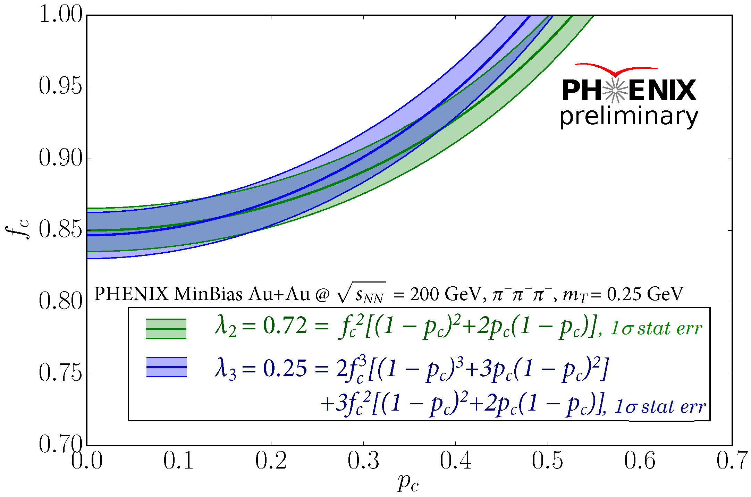
Plots Requested for PHENIX Preliminary

Slide 8
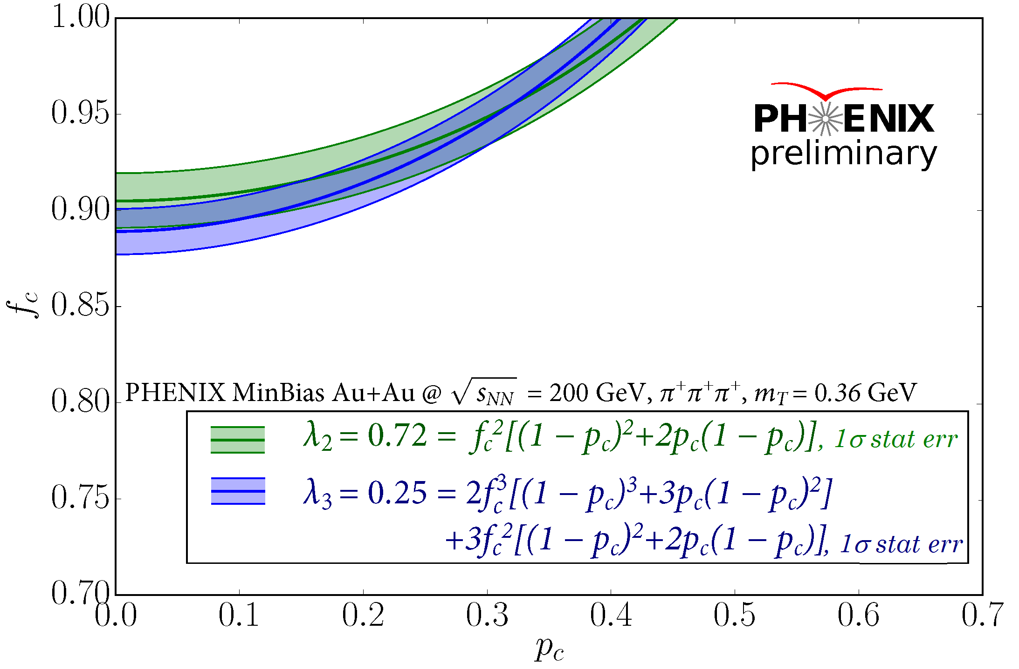
Plots Requested for PHENIX Preliminary

Slide 9
Basic Information
Data set: Run-10 Au+Au 200 GeV MinBias
Data provenance (i.e. reconstruction tag): pro84
Analysis code location in CVS (required):
recalibration, compressed DST generation (see AN1187):
offline/AnalysisTrain/hadrons_run11/train_sources/hadron_pid_dst/
Measurement: offline/analysis/hbtmeasure_3particle/
Fitting: offline/analysis/hbtlevyfit_3particle/
Basic analysis cuts (details in AN1288):
used event cuts:MinBias, |zvtx|<30 cm
track cuts: quality, n0, usual TOF,ECENT cuts, 2s (dphi, dz) in PbSc/TOF
pion PID: 2s m2 cut in PbSc/TOF.E/TOF.W, 2.5s veto for K, p
two track cuts (explained in AN1244):
- tower/slat/strip ID cut
- customary shaped cuts in DCH zed/phi and PbSc, TOF zed/phi
event mixing: 3% wide centrality & 2cm wide zvtx bins.

Slide 10
Basic Information & Provenance, part 2
Please list all recalibrators used in this analysis
centrality calibration, beam shift & mom. scale calibration
Pbsc hadron timing, TOF East/West timing, PID variable tuning
PbSc/TOF/PC2/PC3 hadron track matching
Were any of these not in the MasterRecalibrator?
- only centrality, beam shift & mom. scale calibration is from MasterRecal
- others are private calibrations (done specifically for this analysis)
Location in CVS of Recalibrator codes
- see AN1187; general location: offline/AnalysisTrain/hadrons_run11/
- DST used for this corr. func. measurement generated with Taxi 5202:
offline/AnalysisTrain/hadrons_run11/train_sources/hadron_pid_dst

Slide 11
What’s the observable
What observable is analyzed?
Three particle Bose-Einstein correlation and theri Levy parameters, in 29 p_{t} bins, from 180 to 780 MeV/c
What will be plotted?
Correlation strength (λ₃), Core-Halo independent parameter (κ₃) as function of m_{t}
f_{c}-p_{c} plots for partial coherence
What’s new about this result?
Three particle correlation functions with Levy sources
What is the question that this new result will answer?
Pion production mechanism details beyond core/halo; coherent pion production?

Slide 12
Analysis Issues (~2 slides)
What were the main issues in the analysis?
Visualization of fits, high memory usage of 3D histograms,
slow fit in 3D, many fit parameters
What concerns were raised in PWG meetings?
Why is R, α is taken from PPG194, and not used as fit parameter? What are the f_{c}-p_{c} plots?
What was the resolution for these issues?
We used R, α as fit parameters, the results was consistent with PPG194 (see AN1288 figure 5), but using them from PPG194 reduce the number of parameters and it’s easier and faster to fit. Explanation of f_{c}-p_{c} plots was extended in AN1288 section 6.3.
Page number / figure in AN with the details…
Chapter 4 plots in figure 5
Chapter 6.3

Slide 13
Relation to Previous Analyses
Are there previous results for the same observable?
No
Are there previous results for a related observable?
m_{T}-integrated f_{c}-p_{c} with Gaussian fits (ID p0278, QM05 preliminary) PPG194 partly
Are there any non-PHENIX results for this observable?
No Levy fits was done, no 3D analysis (12, 23, 31)
Similar observable in ALICE measurements: arXiv:1512.08902, arXiv: 1310.7808
Not directly comparable

Slide 14
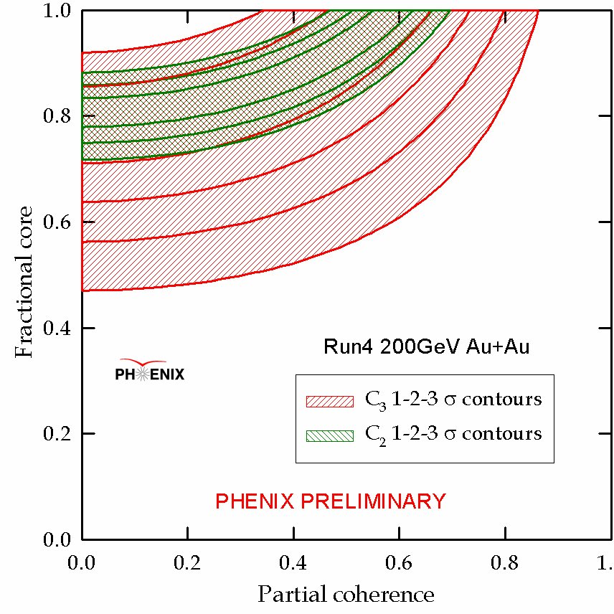


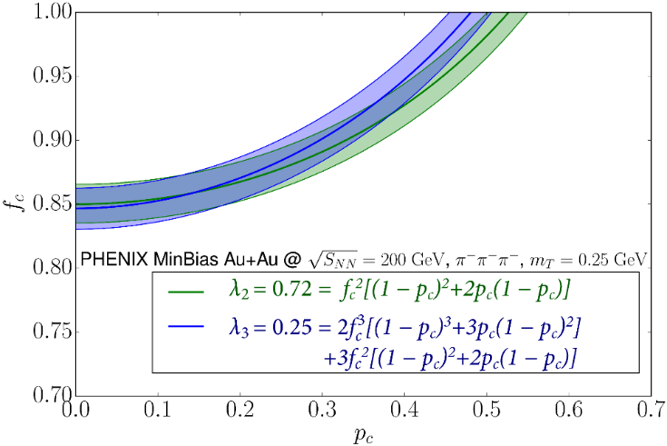
Comparison of New & Old PHENIX Results
Show plot(s) of this comparison
Summarize how good/bad the agreement is
Values of λ₂ and λ₃ give similar (f_{c}, p_{c}) ranges with 1 sigma stat errors Results compatible with partially coherent source
At the given m_{T}, f_{c}<0.82 and p_{c}>0.5 are excluded
Explain any disagreement:
Previous result: not with Levy sources, m_{T}-integrated

Slide 15
What plots are requested preliminary?
Example C₃(k₁₂=k₁₃=k₁₄) diagonal correlation functions with fits (2 plots, p1387)
Correlation strength: λ₃ (1 plot, p1388)
New Core-Halo independent parameter $κ_{3}=\frac{λ_{3}−3λ_{2}}{λ_{2}^{3/2}}$ (1 plot, p1389)
Partial coherence: f_{c}-p_{c} plot, where f_{c} fraction of core, p_{c} fraction of coherent pions (2 plots, p1390)
https://www.phenix.bnl.gov/phenix/WWW/p/plots/show_plot.php?editkey=p1387
https://www.phenix.bnl.gov/phenix/WWW/p/plots/show_plot.php?editkey=p1388
https://www.phenix.bnl.gov/phenix/WWW/p/plots/show_plot.php?editkey=p1389
https://www.phenix.bnl.gov/phenix/WWW/p/plots/show_plot.php?editkey=p1390

Slide 16
Plots Requested for PHENIX Preliminary

Slide 17
Plots Requested for PHENIX Preliminary

Slide 18
Plots Requested for PHENIX Preliminary

Slide 19
Plots Requested for PHENIX Preliminary

Slide 20
Plots Requested for PHENIX Preliminary

Slide 21
Plots Requested for PHENIX Preliminary

Slide 22
Physics Knowledge Gained
What did we learn?
Strength of three-particle correlations (λ₃) within the core-halo&thermal emission limits (0-5) at all m_{T} values
Two- and three-particle correlation strength values (λ₂ & λ₃) are consistent within 1 sigma in an extended region on the (f_{c}, p_{c}) plots at various values of m_{T}.
In statistically significant manner we can exclude:
small values of halo contributions(f_{c} < 0.82 region)
scenario that partial coherence is dominant (p_{c} > 0.5 region)
A small (p_{c} < 0.5) partial coherence cannot excluded.
Possibility of coherent particle production or other deviations from thermal emission
Model-dependent possibility for extracting coherent pion fraction
If comparisons to theoretical models, provide plots and direct links to arXiv papers
D. Gangadharan, Phys.Lett. B762, arXiv:1605.07296
S. Akkelin et al., Phys.Rev. C65 (2002) 064904.
T. Csörgő, Phys. Lett. B409 (1997) 11, hep-ph/9705422
T. Csörgő, Heavy Ion Physics 15 (2002) 1, hep-ph/0001233

Slide 23
The Path to Final Results
What improvements are expected for the final results
Better numerical calculation for Coulomb factor
m_{T} dependent determination of the excluded regions
Is all the data available used ?
Yes (Run10) How much statistical / systematical gain?
Not much change expected
What is the timescale to achieve final result ?
1-1.5 month until Coulomb correction calculated
Will have to see about 4-pion correlations
Work will be done by: Attila Bagoly, Máté Csanád

Slide 24
Any Other Information
We are thinking about measuring 4-pion correlations

